Slide 1
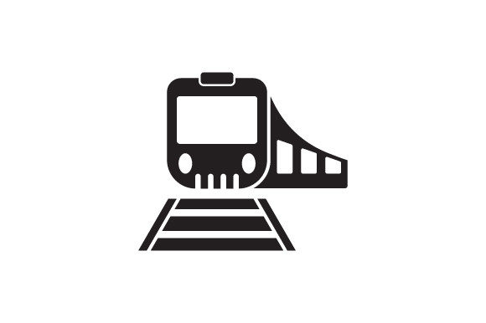
Train Management System Database
Submitted to,
Alif Ruslan
Assistant Professor
Dept of CSE, UAP
December 3, 2024

Slide 2

Team Members
Name | ID
Md Noushad Jahan Ramim | 22201257
Janaid Abedin Rafi | 22201265
.
.

Slide 3


Introduction
A Train Management System designed to manage train schedules, reservations, and operational logistics
It enables the admin to register a train into the system, store routes and schedule details in the database
Admin can add, view, edit, update or delete data.

Slide 4
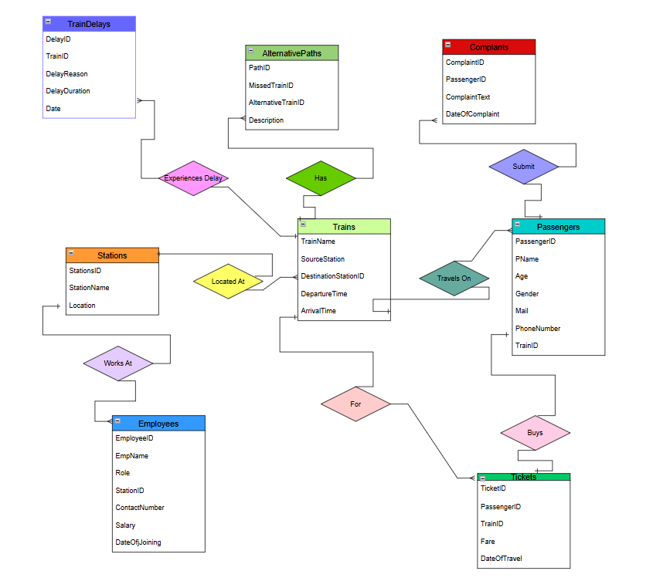
ER Diagram

Slide 5
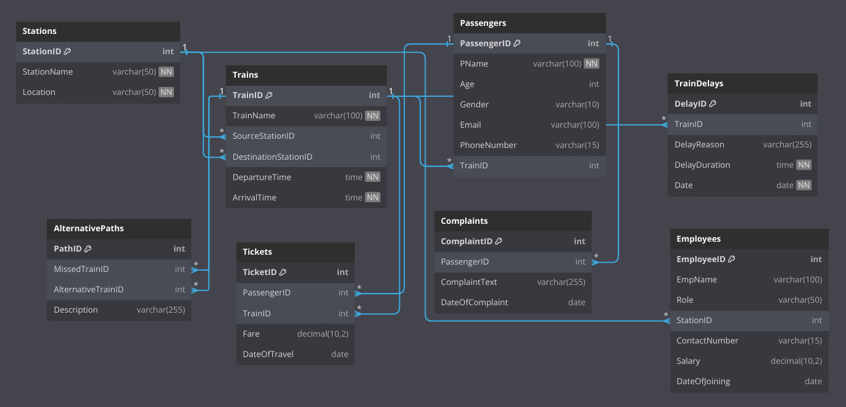
Schema Diagram

Slide 6
Tables
Table Name: Stations
Columns
StationID (INT, Primary Key)
StationName (VARCHAR(50), NOT NULL)
Location (VARCHAR(50), NOT NULL)
Primary Key: StationID
Foreign Keys: None
Table Name: Trains
Columns:
TrainID (INT, AUTO_INCREMENT, Primary Key)
TrainName (VARCHAR(100), NOT NULL)
SourceStationID (INT, Foreign Key referencing Stations(StationID))
DestinationStationID (INT, Foreign Key referencing Stations(StationID))
DepartureTime (TIME, NOT NULL)
ArrivalTime (TIME, NOT NULL)
Primary Key: TrainID
Foreign Keys:
SourceStationID → Stations(StationID)
DestinationStationID → Stations(StationID)

Slide 7
Tables
Table Name: Passengers
Columns:
PassengerID (INT, AUTO_INCREMENT, Primary Key
Passenger Name (VARCHAR(100), NOT NULL)
Age (INT)
Gender (VARCHAR(10))
Email (VARCHAR(100))
PhoneNumber (VARCHAR(15))
TrainID (INT, Foreign Key referencing Trains(TrainID))
Primary Key: PassengerID
Foreign Key::TrainID
Table Name: TrainDelays
Columns:
DelayID (INT, AUTO_INCREMENT, Primary Key)
TrainID (INT, Foreign Key referencing Trains(TrainID))
DelayReason (VARCHAR(255))
DelayDuration (TIME, NOT NULL)
Date (DATE, NOT NULL)
Primary Key: DelayID
Foreign Key:
TrainID → Trains(TrainID)

Slide 8
Tables
Here are the table details for your database, trainmanagementsystem, based on the provided schema:
Table Name: AlternativePaths
Columns:
PathID (INT, AUTO_INCREMENT, Primary Key)
MissedTrainID (INT, Foreign Key referencing Trains(TrainID))
AlternativeTrainID (INT, Foreign Key referencing Trains(TrainID))
Description (VARCHAR(255))
Primary Key: PathID
Foreign Keys:
MissedTrainID → Trains(TrainID)
AlternativeTrainID → Trains(TrainID)
Table Name: Tickets
Columns:
TicketID (INT, AUTO_INCREMENT, Primary Key)
PassengerID (INT, Foreign Key referencing Passengers(PassengerID))
TrainID (INT, Foreign Key referencing Trains(TrainID))
Fare (DECIMAL(10, 2))
DateOfTravel (DATE)
Primary Key: TicketID
Foreign Keys:
PassengerID → Passengers(PassengerID)
TrainID → Trains(TrainID)

Slide 9
Tables
Table Name: Complaints
Columns:
ComplaintID (INT, AUTO_INCREMENT, Primary Key)
PassengerID (INT, Foreign Key referencing Passengers(PassengerID))
ComplaintText (VARCHAR(255))
DateOfComplaint (DATE)
Primary Key: ComplaintID
Foreign Key:
PassengerID → Passengers(PassengerID)
Table Name: Employees
Columns:
EmployeeID (INT, AUTO_INCREMENT, Primary Key)
EmpName (VARCHAR(100))
Role (VARCHAR(50))
StationID (INT, Foreign Key referencing Stations(StationID))
ContactNumber (VARCHAR(15))
Salary (DECIMAL(10, 2))
DateOfJoining (DATE)
Primary Key: EmployeeID
Foreign Key:
StationID → Stations(StationID)

Slide 10

Features
Main Features:
Ticket Booking
Enables passengers to book tickets with detailed fare and travel date tracking.
Train Schedule Management
Manages train schedules, including departure and arrival times at various stations.
Route Management
Tracks and manages train routes, offering alternative paths for delays or missed connections.
Passenger Data Management
Maintains a database of passenger details, including assigned trains and tickets.
Data Analytics for Operational Improvements
Provides insights from collected data to improve train punctuality, passenger satisfaction, and operational efficiency.
Complaint Handling System
Allows passengers to lodge complaints for service monitoring and customer satisfaction.
Employee Management
Tracks employee roles, salaries, and station/train assignments for operational staff.
Delay Tracking
Logs train delays with reasons and durations to ensure better service reliability.

Slide 11

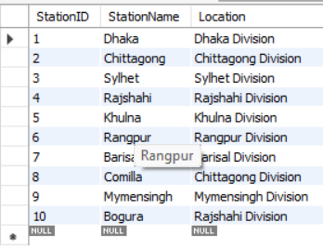
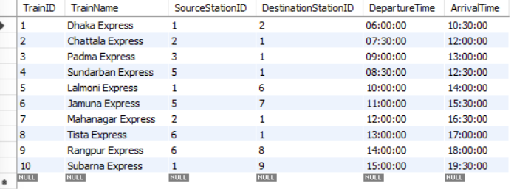
SQL Queries

Slide 12
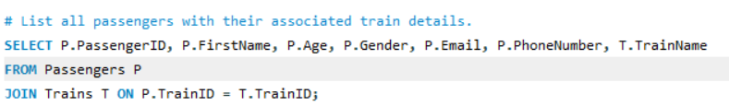
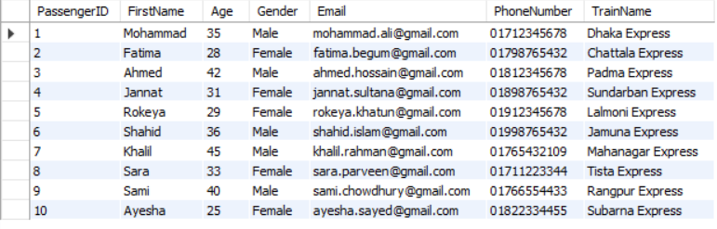
SQL Queries

Slide 13
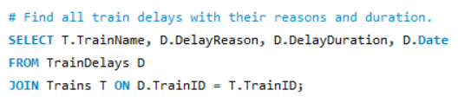
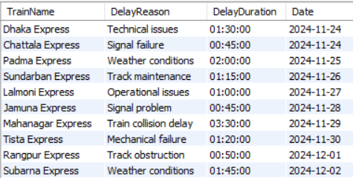
SQL Queries

Slide 14
Challenges
Technical Challenges:
Designing efficient relationships between entities (e.g., trains, routes, and passengers).
Ensuring data consistency and accuracy while managing interrelated tables.
Handling large datasets for train schedules, passenger bookings, and operational data.
Optimizing queries for fast data retrieval in complex operations like schedule or route management.

Slide 15
Future Improvements
Integration with Real-time GPS Tracking:
Mobile Application Development:
Automation of Schedule Updates:
AI-based Analytics

Slide 16
Conclusion

Slide 17

question

Slide 18
